Slide 1
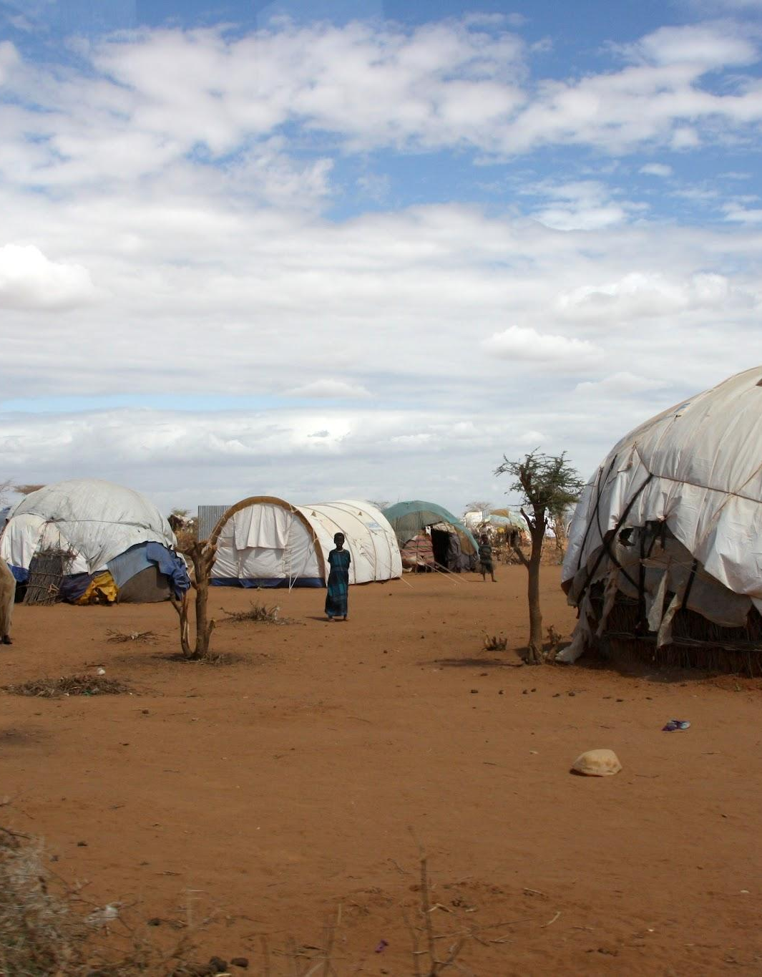
Tailoring Health Delivery for Hard-To-Reach Populations in NTDs.
Jacinta Ifunanya Azie, Ana Krause, Sarah Hicks, Carol Levin.
June 2023

Slide 2
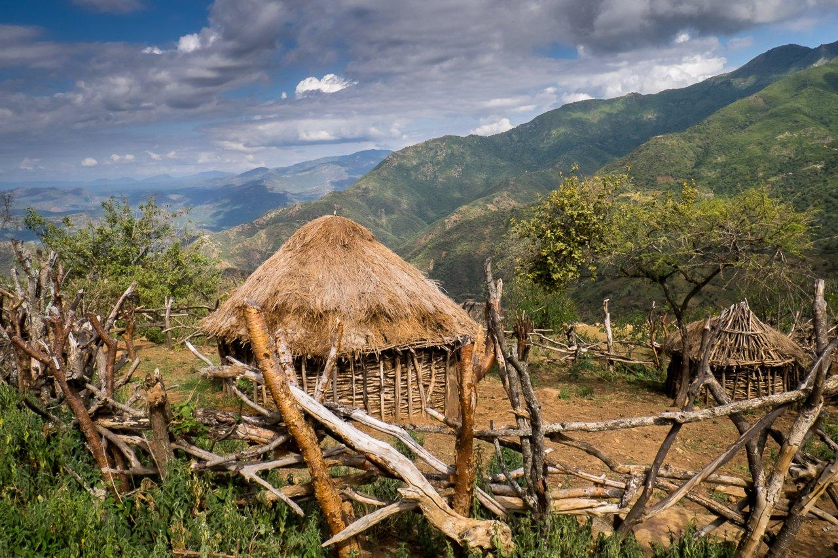
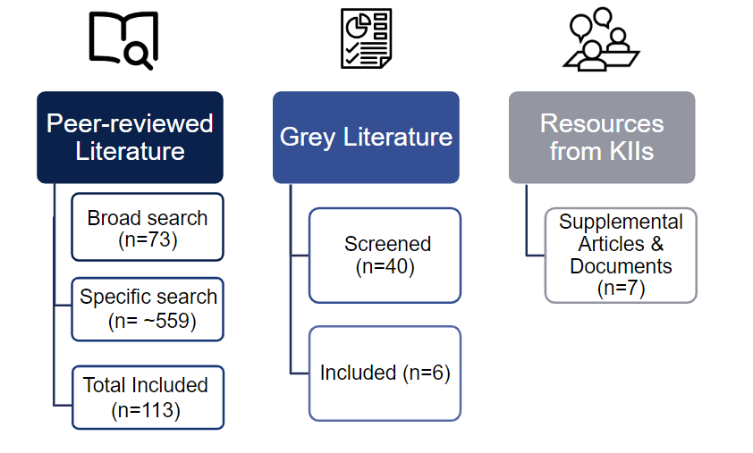
PROJECT OVERVIEW
Motivation: Research results will inform investment decisions made by the BMGF NTD team.
Project Objectives
1
To extract current evidence-based literature on established and potential strategies to engage and tailor NTD interventions for hard-to-reach populations (HTRPs).
To identify optimal channels for delivering services to hard-to-reach populations and extract learnings from other health and non-health areas, strategies used to reach these HTRPs.
2
Research Questions
Who are these “hard-to-reach populations” in NTD?
Who is being missed in reach and why?
What interventions have proven promising in reaching these “hard-to-reach populations”?
Project Background
Neglected tropical diseases (NTDs) are a group of preventable and treatable parasitic, viral, bacterial, fungal, and non-communicable diseases that affect more than one billion people globally¹.
Of the twenty (20) NTDs in the world, five (5) account for the largest burden of disease and can be targeted with safe and effective medicine.
To achieve elimination targets, it is critical to identify hard-to-reach populations, assess the barriers hindering uptake of NTD programs and explore optimal channels for expanding coverage.
METHODS
Scoping Review of Published Literature
Initial broad search using a comprehensive search string
Population specific search using different search strings for each target population.
Literature Review
Grey Literature
Reviewed INGO and NGO strategy documents, conference records and toolkits.
Grey Literature
Expert Opinions
Eight (8) subject matter experts (SMEs) in hard-to-reach populations for NTDs and non-NTDs.
SMEs
UW START CENTER 1

Slide 3
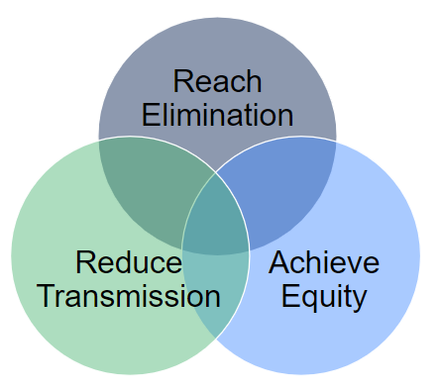
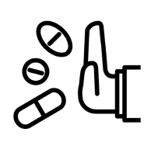
HARD-TO-REACH POPULATIONS IN NTDs
Hard-to-reach populations are often sub-groups of the general population that have higher exposure to infection and/or are missed by health services and interventions.
Due to the variability and complexity of NTDs, HTRPs in NTDs can vary across regions, even within the same country, and for each specific NTD.²
There are three main reasons why we care about delivering NTD preventative and treatment services to HTRPs: to (1) reach elimination targets; (2) reduce transmission and (3) achieve equity. Epidemiologically, untreated individuals can contribute to ongoing transmission. Therefore, ensuring widespread outreach is crucial for NTD elimination. Also, ensuring equitable access to all especially, marginalized populations of which these hard-to-reach populations fall within is critical to reaching universal health coverage (UHC).³
HARD-TO-REACH POPULATION CATEGORIES FOR NTDs
Nomadic/Pastoralist
Populations who have no fixed residence but move from place to place usually seasonally and within a well-defined territory.
Conflict +IDP Camps
Populations living in a place marked by increased disruption of normal life activities due to war.
Refugee
Populations who have been forced to leave their country in order to escape war, persecution, or natural disaster.
People who refuse treatment
A group who may be hard to reach due to factors such as distrust, stigma, and social influences.
Cross Border
Populations who reside in border crossing points and transit hubs.
Low SES/Poverty
HTR groups due to their physical location, social disadvantages or economic situation, related to structural barriers to services and social determinants of health.
Remote Settings
Geographically isolated populations due to one or more factors including distance, terrain, infrastructure, and/or climate.
Specific Ethnic Group
Ethnic groups facing one or more factors, such as location, mobility, cultural or traditional values affecting demand or reach of services.
UW START CENTER 2

Slide 4
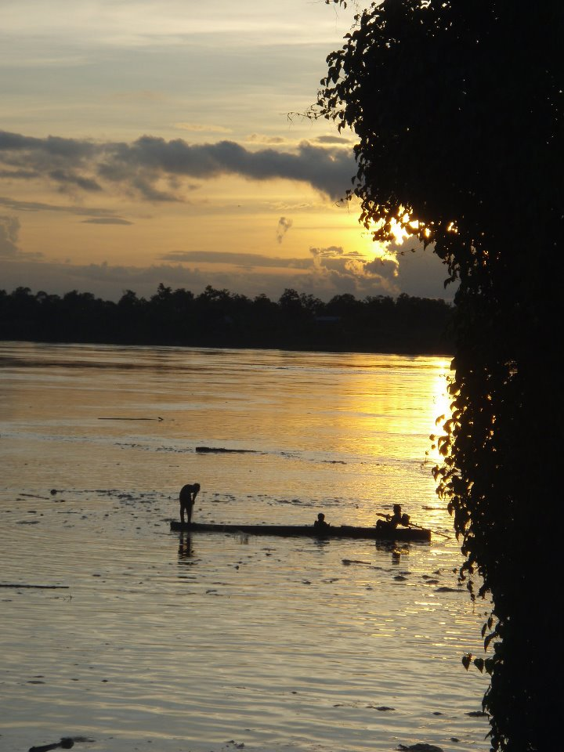
OPPORTUNITIES TO EXPAND REACH OF EXISTING PROGRAMS
By design, existing programs may be missing HTRPs.
Limitation
Concern
Possible Strategy
Inaccurate MDA Registers.
May be systematically missing certain groups (e.g., urban poor, informal settlements).
Increased community collaboration before/during campaigns.
Lack of Disaggregated Data.
Limits understanding of who is being missed (e.g., gender, age, etc.).
Encourage/advise NTD programs to gather more detailed data.
WHO Mapping Protocol's use of Convenience Sampling.
May be systematically missing certain groups.
Detailed mapping.
Insufficient Time.
Limits interactions with resistant individuals + revisiting houses where no one was home.
Extend duration of MDA campaigns beyond several days/weeks.
Tool Limitations.
MDA dose pole ill-adapted for stunted or disabled populations.
Consider alternative strategies for dosing (e.g., weight-based).
Poor Implementation.
Ignoring context limits program reach (e.g., rainy season, Ramadan).
Microplanning.
*MDA: Mass Drug Administration Source: 4,5,6,7,8,9
IMPLEMENTATION CONSIDERATIONS FOR HTRP PROGRAMS
There are many different barriers or population characteristics that might contribute to a population being HTR including: geography, conflict, absence due to occupation or lack of awareness of interventions, wider movement patterns of migratory groups, children not enrolled in school, unique recipient factors such as ethnicity/language/cultural beliefs, and/or refusals or fear of side effects particularly around women's reproductive health/fertility which volunteer drug distributors are often not equipped to answer.^{6,10,9} Responding to each of these barriers or characteristics requires at a minimum, additional time, attention, planning, and partnership in order to address population, individual, and program factors to improve program reach.
Notably, the tools and strategies that have helped NTD programs make huge strides for most of the population may not be the same tools for the ‘last mile efforts’ as they are not sufficiently adapted to HTRPs.
UW START CENTER 3

Slide 5
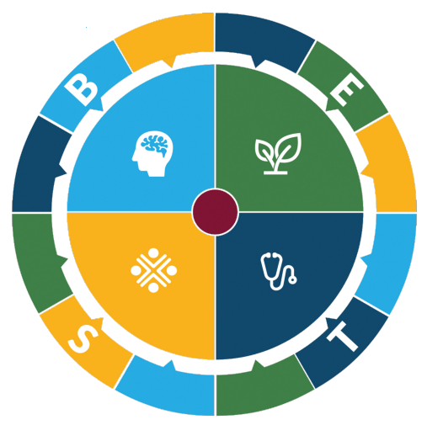
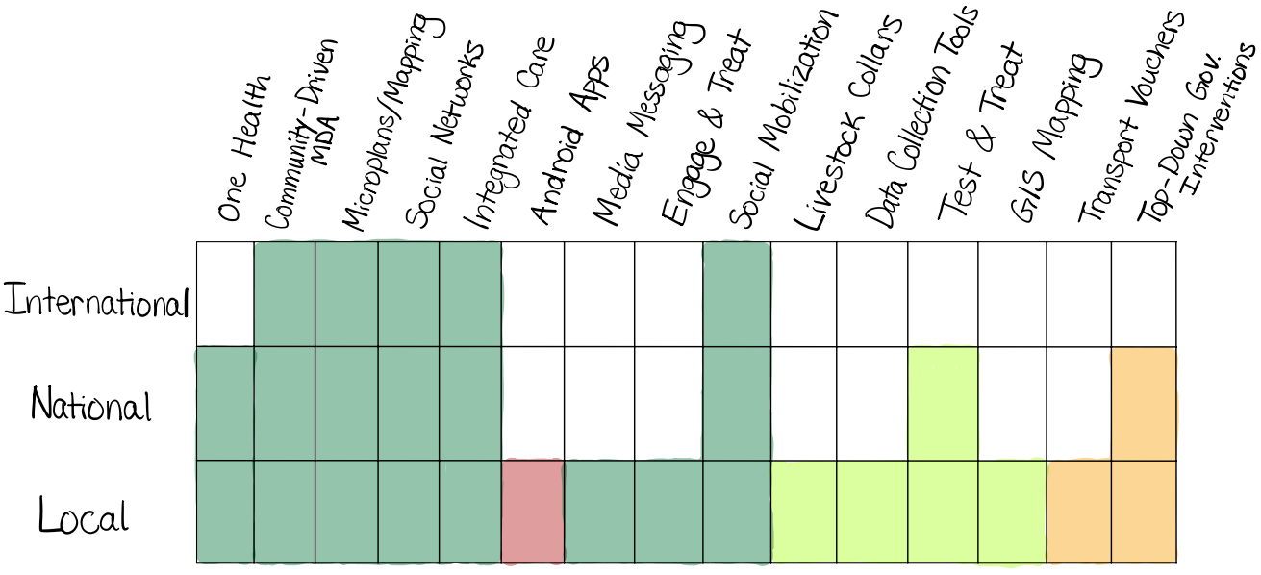
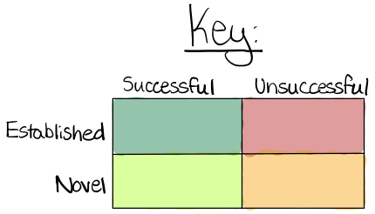
SUMMARY OF FINDINGS
In order to identify the types of strategies that have been used across the range of HTRPs, our findings from the literature reviews were classified into the BEST Framework, developed by the Neglected Tropical Disease NGO Network.¹¹ This framework helps us evaluate the distribution of Behavioral, Environmental, Social Inclusion, and Treatment interventions that have been tested within each HTRP.
The plurality of the 113 included articles fell under the Treatment category (47%) followed by Behavior (27%), Social Inclusion (16%) and Environment (9%).
Primary BEST Category | Nomadic (N=25) | Cross- Border (N=6) | Remote Location (N=29) | Ethnic Groups (N=8) | Conflict Zones & IDPs (N=7) | People who Refuse Treat- ment (N=9) | Low SES (N=11) | Refugee Groups (N=18) | TOTAL (N=113)
Behavior | 7 (26%) | 2 (33%) | 13 (45%) | 3 (38%) | 2 (29%) | 2 (22%) | 2 (18%) | 0 (0%) | 31 (27%)
Environ-ment | 0 (0%) | 0 (0%) | 3 (10%) | 0 (0%) | 0 (0%) | 0 (0%) | 1 (9%) | 6 (32%) | 10 (9%)
Social Inclusion | 4 (18%) | 0 (0%) | 4 (14%) | 5 (62%) | 0 (0%) | 1 (12%) | 3 (27%) | 1 (5%) | 18 (16%)
Treat- ment | 14 (56%) | 4 (66%) | 9 (31%) | 0 (0%) | 5 (71%) | 6 (66%) | 5 (45%) | 11 (58%) | 54 (47%)
STRATEGY OVERVIEW
Established strategies such as community-driven MDA, micro planning, leveraging existing social networks and partnerships, social mobilization and providing integrated care (including One Health interventions) proved most successful from the local to international levels.
Novel strategies such as GIS mapping, livestock collars, and ‘test & treat’ interventions had some evidence of success, primarily at the local level.
UW START CENTER 4

Slide 6
SUMMARY OF SUCCESSFUL STRATEGIES
The following ten strategies had success in reaching HTRPs as part of NTD programming, when introduced either independently or in combination.
One Health Approaches
The joint delivery of human + animal health services (e.g., child + animal vaccination campaigns).^{12,13,14,15} Particularly useful for pastoralist communities where livestock are highly valued. Vaccination increased +176% among nomadic children in the intervention group vs. -71% in the control group.
Micro Planning
Detailed organization, planning, + management of all NTD intervention elements at the district level. A bottom-up approach.¹⁸ Helped identify 200 new settlements in Somalia.
Community Driven MDA
Engaging local community members to deliver MDA, can be more cost-efficient + increase uptake due to established trust.²⁰
Social Mobilization
Engaging or identifying HTRPs through community networks and interpersonal communication. ^{21,22} Established strategy in combination with others to increase intervention uptake.
Engage + Treat
The active identification of individuals who were missed during a campaign (e.g., due to work, travel, etc.) to offer treatment.⁴ Contributed to a 97% uptake of MDA in target community, along with other strategies.
Livestock Collaring
Allows for tracking of livestock &/or pastoralist community movements using apps. Reports from the field indicate interest among pastoralist communities as also offers a means of preventing livestock from being stolen during frequent raids.
Integrated Care
The joint delivery of NTD + other health services (e.g., MDA + vaccinations). ²³ NTD program capitalizes on more valued health interventions to increase uptake or identify co-infections. Malaria + intestinal co-infections identified in 41-48% of IDP children ages 5-15 years in Nigeria.
Test + Treat
The active identification of individuals who previously refused treatment to offer testing + treatment. ^{4,19} Performing a point-of-care test to show a need for treatment can increase uptake. No treatment if negative test Contributed to a 97% uptake of MDA in target community along with other strategies.
Mapping Hotspots
Use of GIS or fine-scale mapping to map high endemicity hotspots. ^{16,17} More detailed mapping provided greater understanding of new transmission risks in an urban poor environment in Brazil.
Enhanced Data Collection
Use of interoperable data collection devices such as ODK to gather coverage data post MDA. Particularly useful in displaced settings where it is difficult to track human movement.
SUMMARY OF LESS SUCCESSFUL STRATEGIES
Animal Enclosures
Although described as being well researched, these were broadly rejected by a Sudanese community. Government enforcement worsened perceptions of the intervention.²⁴
Mobile Transport Vouchers
Variable success when used for a maternal health project due to structural barriers including lack of phone ownership, low literacy, poor network and in.²⁵
Digital Health
Interventions cannot overcome structural barriers, especially for chronic diseases, may not integrate with health system infrastructure, and are not always seen as a priority by target population.²⁶
UW START CENTER 5

Slide 7
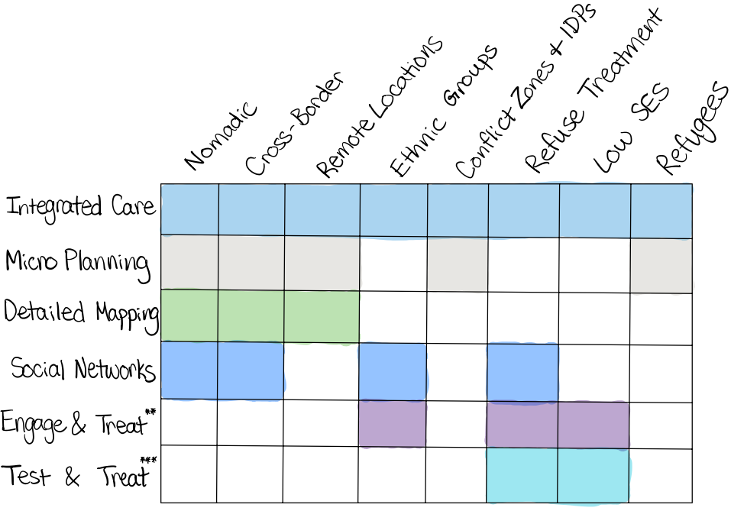
PROMISING STRATEGIES- POPULATION SPECIFIC
The figure to the right maps six promising strategies that have been used with specific hard-to-reach populations. These six strategies can be used for multiple NTDs and can be combined with one another.
Each of these strategies generally requires increased collaboration with communities, which can build trust with the populations of interest and can be more resource intensive.
However, through these collaborations, programs are also more likely to expand their reach to HTRPs.
DRIVERS OF SUCCESS FOR PROMISING STRATEGIES
 | Integrated Care |  | Micro Planning
Summary: Integrated care involves the combination of NTD care with other healthcare services, including vaccination campaigns and maternal and child health. MDA delivery was most integrated with animal vaccine campaigns via a One Health approach.²⁷ Drivers of Success: Leveraging pre-existing partnerships with Ministries of Health and Livestock or others who are already conducting vaccine campaigns. Providing campaigns in centralized locations (e.g., outside primary schools, village centers). |  | Summary: Micro planning is a cyclical process that is used to define the activities, resources, timing, and location of implementation and monitoring of preventive chemotherapy administration.²⁸ Mapping is often integrated into the micro planning process to identify points of contact with nomadic communities including watering and grazing locations and local markets.¹⁸ Drivers of Success: Community leadership as point of contact. Cross-border meetings between local health officials and communities to understand migration patterns.
 | Detailed Mapping |  | Social Networks
Summary: Construction of detailed maps among nomadic populations is beneficial for identifying MDA delivery locations around seasonal migratory patterns. Mapping can be done through microplanning, or newer technologies such as geographic information systems (GIS) and platform transmitter terminals (PTTs).²⁹ Drivers of Success: Community leader engagement via microplanning. PTTs and GIS provide more granular data but often at higher costs. |  | Summary: Utilizing social networks via community health workers and volunteers is critical for sensitization efforts prior to MDA delivery.²¹ The use of social networks in cross-border efforts is particularly of interest to achieve NTD elimination.²² Drivers of Success: Inclusion of local leadership, particularly as a point of first contact. Cross-border collaboration driven by external stakeholders. Joint priorities for elimination and capacity-building.
UW START CENTER 6

Slide 8
 | Engage & Treat |  | Test & Treat
Summary: ‘Engage & Treat’ refers to the active identification of missed individuals to offer treatment; this includes individuals who were at work, traveling, etc. rather than those who refused treatment.⁴ Drivers of Success: Verifying accuracy of MDA registers. Community mapping of missed participants aided in active identification. Use of social networks to identify missed participants. |  | Summary: ‘Test & Treat’ refers to the active identification of missed individuals who refused MDA to offer testing and treatment.^{4,19} Drivers of Success: Performing a point-of-care test and showing a need for treatment increases uptake and reduces suspicion among target populations being asked to consume MDA. Individuals who test negative are not treated.
NOVEL VS. ESTABLISHED STRATEGIES
Novel Strategies may have a Role in Reaching HTRPs
Our literature review and interviews revealed that established strategies are currently the clear path forward for programs aiming to reach HTRPs. Furthermore, academic literature alone may not provide sufficient detail to inform programming and will require insights from the field particularly as many articles tend to focus on efficacy over implementation details. One example of this limitation would be Haiti’s NTD program which is described as reaching 100% geographical coverage over 14 years, but minimal detail on how this coverage was achieved.³⁰
BUT Established Strategies are currently more Robust, Scale-able, and Sustainable if Tailored to population needs
CONCLUSIONS
Additional Considerations for HTRPs.
Ethical Issues:
It is important to recognize that some HTRPs may not want to be reached by health programs (e.g., isolated tribes, parents not wanting their non-infected children to be MDA recipients, etc.). Alternative approaches may be needed.^{8,31}
Emphasis of MDA in HTR areas over other essential and life-saving medications can exacerbate feelings of marginalization in some communities, as their most pressing health needs are not being met.
However, this may present opportunities for further integration of care (e.g., integrating supply chains and/or essential care with MDA campaigns).
Considerations for all HTRPs
Reaching HTRPs requires tailored and context-specific approaches.
One size does not fit all.
Communities are not homogenous.
Don't dismiss the non-flashy innovations.
Trust and relationship building can be foundational to HTRP intervention success.
Investing in established strategies is more scalable and sustainable.
Programming should involve additional attention, partnership, planning, and time.
Consider integrated approaches to care.
Capitalize on and support existing infrastructure and programming with greater community buy-in.
Parallel programming is also a more resource intensive approach.
UW START CENTER 7

Slide 9
APPENDICES
SUBJECT MATTER EXPERTS (SMEs)
With expertise in NTDs &/or HTRPs
were interviewed between April-June 2023
Julianne Meisner (UW: Dept. of Environmental & Occupational Health Sciences)
Ariana Means(UW: Dept. of Global Health)
Julie Jacobson (Bridges to Development: NTD Implementation expert)
Sian Freer (LSHTM: COO; Centers for Neglected Tropical Diseases)
Folake Olayinka (USAID Immunization Technical Lead).
Margaret Baker (GU: NTD & infectious disease Implementation expert).
Elizabeth Long (Associate Director of Programs, COR-NTD).
Jamie Tallant (Associate VP, END Fund).
BROAD SEARCH STRINGS
Search String | Results
NTD specific results (“neglected diseases”[MeSH] OR “neglected disease*” or “neglected tropical disease*” OR “NTD*” OR “helminthiasis”[MeSH] OR “leprosy”[MeSH] OR “lymphatic filariasis”[MeSH] OR “onchocerciasis”[MeSH] OR “schistosomiasis”[MeSH] OR “trachoma”[MeSH]) AND (“Primary prevention”[MeSH] OR “Secondary prevention”[MeSH] OR “intervention*”) AND (“difficult to reach” OR “hard to reach” OR “HTR*” OR “HTRP*” OR “hard-to-reach” OR “hard-to-reach population” OR “hard to reach population”) | 16
Non-NTD specific results (“Primary prevention”[MeSH] OR “Secondary prevention”[MeSH] OR “intervention*”) AND (“difficult to reach” OR “hard to reach” OR “HTR*” OR “HTRP*” OR “hard-to-reach” OR “hard-to-reach population” OR “hard to reach population”) AND (“developing countries”[MeSH] OR “developing countr*” OR “LMIC*” OR “low and middle income countr*” OR “low income countr*” OR “middle income countr*”) | 57

Slide 10
APPENDICES
SPECIFIC SEARCH STRINGS
HTRP | Search String | Initial Results | Relevant Papers
Nomadic Populations | ((pastoral OR nomad* OR migrant* ) AND (interventions OR access OR reach)) AND ("neglected tropical disease*" OR NTD OR "neglected disease*") | 59 | 20
Cross-Border Areas | (("cross border" OR "border cross*") AND (interventions OR access OR reach)) AND ("neglected tropical disease*" OR NTD OR "neglected disease*") | 10 | 6
Refugees | (("refugees"[MeSH] OR "refugee*" or "asylum seeker" OR "Refugee camps"[MeSH] OR "refugee camp*") AND (interventions OR access OR reach)) AND ("neglected tropical disease*" OR NTD OR "neglected disease*") | 25 | 18
Conflict Zones & IDPs | (("Armed Conflicts"[MeSH] OR "conflict zone*" ) AND (interventions OR access OR reach)) AND ("neglected tropical disease*" OR NTD OR "neglected disease*") (("internally displaced people" OR "internally displaced" OR "internally displaced person*" OR "IDP" OR "IDPs") AND (interventions OR access OR reach)) AND ("neglected tropical disease*" OR NTD OR "neglected disease*") | 5 12 | 7
Remote Populations | (("rural population"[MeSH] OR "rural health services"[MeSH] OR "remote" OR "remote location*" OR "remote population*") AND (interventions OR access OR reach)) AND ("neglected tropical disease*" OR NTD OR "neglected disease*") | 249 | 29
People Who Refuse Treatment | ((treatment refusal OR refused* ) AND (interventions OR access OR reach)) AND ("neglected tropical disease*" OR NTD OR "neglected disease*") | 71 | 19
Ethnic Groups/Low SES | ("Peul" OR "Tuareg" OR "Mursi" OR "Hamar" OR "Oromo" OR "Karo" OR "Daasanach" OR "Afar" OR "Ogiek" OR "Sengwer" OR "Yaaku Waata" OR "Sanya" OR "Endorois" OR "Turkana" OR "Maasai" OR "Samburu" OR "Wolof" OR "Fula" OR "Serer" OR "Jola" OR "Dinka" OR "Shilluk" OR "Lango" OR "Kakwa" OR "Didinga" OR "Balanda Bviri" OR "Bahr el Ghazal" OR "Guor Marial" OR "Dongotono" OR "Pojulu" OR "Mbororo Fulani" OR "Toubou" OR "Yoruba" OR "Igbo" OR "Kanuri" OR "Ijaw" OR "Ibibio" OR "Edo" OR "Itsekiri" OR "Idoma" OR "Igala" OR "Efik" OR "Isoko") AND (interventions OR access OR reach) AND ("neglected tropical disease*" OR NTD OR "neglected disease*") ( "Mbororo Fulani" OR "Afar") AND (interventions OR access OR reach) AND ("neglected tropical disease*" OR NTD OR "neglected disease*") | 12 22 | 7 1

Slide 11
REFERENCES
Adams, M.W., Sutherland, E.G., Eckert, E.L. et al. Leaving no one behind: targeting mobile and migrant populations with health interventions for disease elimination—a descriptive systematic review. BMC Med 20, 172 (2022). https://doi.org/10.1186/s12916-022-02365-6.
Ozawa S, Yemeke TT, Evans DR, Pallas SE, Wallace AS, Lee BY. Defining hard-to-reach populations for vaccination. Vaccine. 2019 Sep 3;37(37):5525-5534. doi: 10.1016/j.vaccine.2019.06.081. Epub 2019 Aug 7. PMID: 31400910.
Vegvari, C., Truscott, J.E., Kura, K. et al. Human population movement can impede the elimination of soil-transmitted helminth transmission in regions with heterogeneity in mass drug administration coverage and transmission potential between villages: a metapopulation analysis. Parasites Vectors 12, 438 (2019). https://doi.org/10.1186/s13071-019-3612-7.
de Souza DK, Otchere J, Sumboh JG, et al. Finding and eliminating the reservoirs: Engage and treat and test and treat strategies for lymphatic filariasis programs to overcome endgame challenges. Frontiers in Tropical Diseases. 2022;3. Accessed June 7, 2023.
Ncube, M.V., Kabuyaya, M. & Chimbari, M.J. Patient journey and resources mapping to implement a praziquantel mass drug administration program for children aged 5 years and below in resource-limited settings. Syst Rev 11, 227 (2022). https://doi.org/10.1186/s13643-022-02087-z.
Makia Christine Masong, Kim Ozano, Marlene Siping Tagne, Marlene Ntchinda Tchoffo, Sharon Ngang, Rachael Thomson, Sally Theobald, Louis-Albert Tchuem Tchuenté & Estelle Kouokam (2021) Achieving equity in UHC interventions: who is left behind by neglected tropical disease programmes in Cameroon?, Global Health Action, 14:1, DOI: 10.1080/16549716.2021.1886457.
Sime H, Gass KM, Mekasha S, et al. Results of a confirmatory mapping tool for Lymphatic filariasis endemicity classification in areas where transmission was uncertain in Ethiopia. PLoS Negl Trop Dis. 2018;12(3):e0006325. doi:10.1371/journal.pntd.0006325.
Kisoka W, Mushi D, Meyrowitsch DW, Malecela M, Simonsen PE, Tersbøl BP. DILEMMAS OF COMMUNITY-DIRECTED MASS DRUG ADMINISTRATION FOR LYMPHATIC FILARIASIS CONTROL: A QUALITATIVE STUDY FROM URBAN AND RURAL TANZANIA. Journal of Biosocial Science. 2017;49(4):447-462. doi:10.1017/S0021932016000365.
Sime H, Gass KM, Mekasha S, et al. Results of a confirmatory mapping tool for Lymphatic filariasis endemicity classification in areas where transmission was uncertain in Ethiopia. PLoS Negl Trop Dis. 2018;12(3):e0006325. doi:10.1371/journal.pntd.0006325.
Rilkoff H, Tukahebwa EM, Fleming FM, Leslie J, Cole DC. Exploring Gender Dimensions of Treatment Programmes for Neglected Tropical Diseases in Uganda. PLOS Neglected Tropical Diseases. 2013;7(7):e2312. doi:10.1371/journal.pntd.0002312.
The BEST Framework. NNN. Accessed June 7, 2023. https://www.ntd-ngonetwork.org/the-best-framework.
Bechir M, Schelling E, Wyss K, et al. Innovative approach to vaccinations in public health and veterinary medicine among nomadic pastoralists in Chad: Experience and costs. Tropical Medicine and Health. 2004;64:497-502.
Abakar MF, Schelling E, Béchir M, et al. Trends in health surveillance and joint service delivery for pastoralists in West and Central Africa. Rev Sci Tech Int Off Epizoot. 2016;35(2):683-691. doi:10.20506/rst.35.2.2549.
Bomoi IM, Wazri NE, Nguku P, Tsofo A. Integrated human and animal vaccination delivery to Nomadic Fulani communities in Northern Nigeria 2015. Int J Infect Dis. 2016;45:22. doi:10.1016/j.ijid.2016.02.082.
Kamadjeu R, Mulugeta A, Gupta D, et al. Immunizing nomadic children and livestock – Experience in North East Zone of Somalia. Hum Vaccines Immunother. 2015;11(11):2637-2639. doi:10.1080/21645515.2015.1038682.
Wild H, Glowacki L, Maples S, et al. Making Pastoralists Count: Geospatial Methods for the Health Surveillance of Nomadic Populations. Am J Trop Med Hyg. 2019;101(3):661-669. doi:10.4269/ajtmh.18-1009.
Jean-Richard V, Crump L, Moto Daugla D, Hattendorf J, Schelling E, Zinsstag J. The use of mobile phones for demographic surveillance of mobile pastoralists and their animals in Chad: proof of principle. Glob Health Action. 2014;7(1):23209. doi:10.3402/gha.v7.23209.
Haydarov R, Anand S, Frouws B, Toure B, Okiror S, Bhui BR. Evidence-Based Engagement of the Somali Pastoralists of the Horn of Africa in Polio Immunization: Overview of Tracking, Cross-Border, Operations, and Communication Strategies. Global Health Communication. 2016;2(1):11-18. doi:10.1080/23762004.2016.1205890.
Trippler L, Ali SM, Ame SM, et al. Fine-scale-mapping of Schistosoma haematobium infections at the school and community levels and intermediate host snail abundance in the north of Pemba Island: baseline cross-sectional survey findings before the onset of a 3-year intervention study. Parasit Vectors. 2022;15(1):292. doi:10.1186/s13071-022-05404-6.
Serigne M. Ndiaye and others, Polio Outbreak Among Nomads in Chad: Outbreak Response and Lessons Learned, The Journal of Infectious Diseases, Volume 210, Issue suppl_1, November 2014, Pages S74–S84, https://doi-org.offcampus.lib.washington.edu/10.1093/infdis/jit564.
Ndiaye SM, Ahmed MA, Denson M, et al. Polio Outbreak Among Nomads in Chad: Outbreak Response and Lessons Learned. The Journal of Infectious Diseases. 2014;210(suppl_1):S74-S84. doi:10.1093/infdis/jit564.
Stevens A, Gilder ME, Moo P, et al. Folate supplementation to prevent birth abnormalities: evaluating a community-based participatory action plan for refugees and migrant workers on the Thailand-Myanmar border. Public Health. 2018;161:83-89. doi:10.1016/j.puhe.2018.04.009.

Slide 12
REFERENCES
Edosomwan EU, Evbuomwan IO, Agbalalah C, Dahunsi SO, Abhulimhen-Iyoha BI. Malaria coinfection with Neglected Tropical Diseases (NTDs) in children at Internally Displaced Persons (IDP) camp in Benin City, Nigeria. Heliyon. 2020 Aug 5;6(8): e04604. doi: 10.1016/j.heliyon. 2020.e04604. PMID: 32793830; PMCID: PMC7408312.
Nasr Elsheikh M. ‘Because people here are ignorant’: The failure of a community intervention to prevent mycetoma in Sudan. NIHR Open Res. Published online 2023. doi:10.3310/nihropenres.13330.1.
Ommeh M, Fenenga CJ, Hesp CJ, Nzorubara D, Rinke de Wit TF. Using mobile transport vouchers to improve access to skilled delivery. Rural Remote Health. 2019;19(1):4577. doi:10.22605/RRH4577.
Steinman L, van Pelt M, Hen H, et al. Can mHealth and eHealth improve management of diabetes and hypertension in a hard-to-reach population? —lessons learned from a process evaluation of digital health to support a peer educator model in Cambodia using the RE-AIM framework. Mhealth. 2020;6:40. doi:10.21037/mhealth-19-249.
Lankester F, Davis A, Kinung’hi S, et al. An integrated health delivery platform, targeting soil-transmitted helminths (STH) and canine mediated human rabies, results in cost savings and increased breadth of treatment for STH in remote communities in Tanzania. BMC Public Health. 2019;19:1398. doi:10.1186/s12889-019-7737-6.
9789240049482_eng.pdf. Accessed July 6, 2023. https://iris.paho.org/bitstream/handle/10665.2/56404/9789240049482_eng.pdf?sequence=1.
Sonneveld BGJS, Keyzer MA, Georgis K, Pande S, Seid Ali A, Takele A. Following the Afar: Using remote tracking systems to analyze pastoralists’ trekking routes. Journal of Arid Environments. 2009;73(11):1046-1050. doi:10.1016/j.jaridenv.2009.05.001
Lemoine JF, Desormeaux AM, Monestime F, et al. Controlling Neglected Tropical Diseases (NTDs) in Haiti: Implementation Strategies and Evidence of Their Success. PLOS Neglected Tropical Diseases. 2016;10(10):e0004954. doi:10.1371/journal.pntd.0004954
Hastings J. RUMOURS, RIOTS AND THE REJECTION OF MASS DRUG ADMINISTRATION FOR THE TREATMENT OF SCHISTOSOMIASIS IN MOROGORO, TANZANIA. J Biosoc Sci. 2016 Sep;48 Suppl 1:S16-39. doi: 10.1017/S0021932016000018. PMID: 27428064.

